Slide 1


DOCKER TECHNOLOGY for robotics projects
Name: Trần Nguyễn Phương Trinh
Instructors: Prof. Dr. Peter Nauth
Mr. Julian Umansky
Frankfurt, Germany
February 27, 2020

Slide 2
OVERVIEW
Docker Overview
General Motivation
RaspberryPi Migration
Intel NUC Migration
Docker Limitation

Slide 3
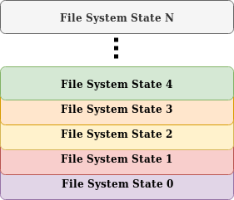
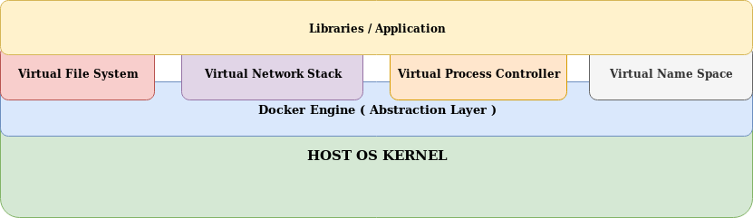
Docker Overview
Docker Image (Dockerfile)
Docker Container (Docker Compose)

Slide 4
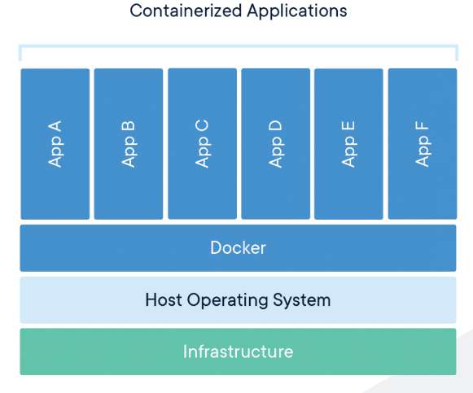
General Motivation
Any robotic project muchly depends on:
Operating System (OS): Ubuntu, Debian, CentOS, etc.
Robot Operating System (ROS) : Indigo, Jade, Kinetic, etc.
Third-party libraries: OpenCV, Eigen, GLU Mesa, CouchDB, Ecto, ORK, etc.
File system:
OS specific: /Users/ (MacOS), /home/ (Linux)
User specific: /home/trinh-pc/hcr/ws
Network Configuration: IP range, IP port, etc.
https://www.docker.com/resources/what-container
The dependency scale will grow along with the project scale!

Slide 5
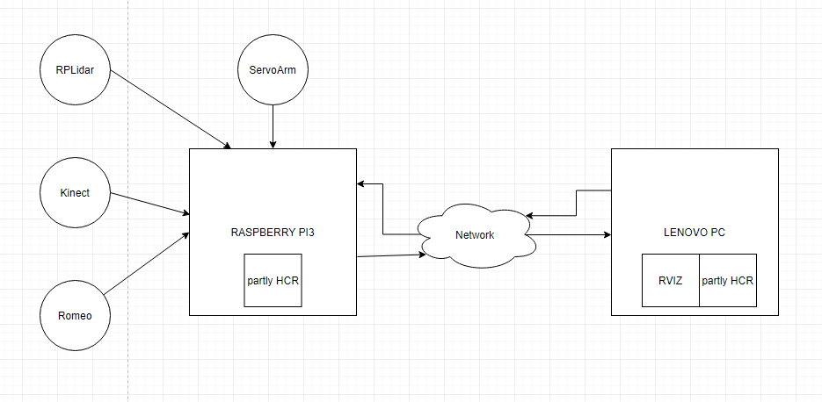
RaspberryPi Migration
Step 1: Encapsulate all dependencies that require for HCR Sofwares (both parts: running on Raspberry Pi 3 as well as PC)
Step 2: Develop Dockerfile from these dependencies.
Step 3: Develop Docker Compose. It will spin up an image, described in Dockerfile, to a container.
Step 4: Develop entry point to start the program into the Docker container.

Slide 6
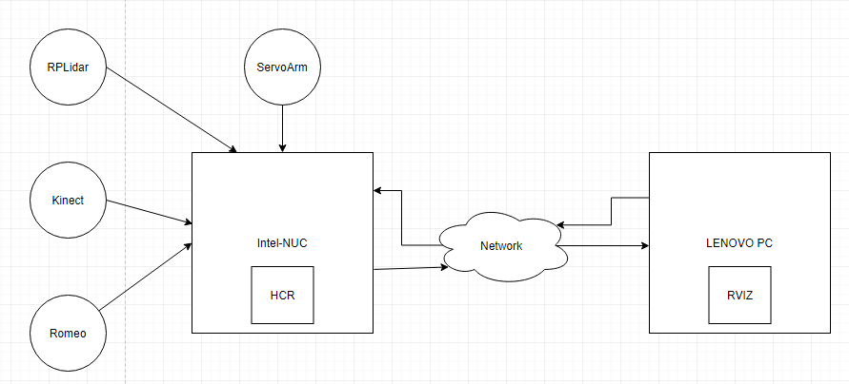
Intel NUC Migration
Step 1: clone new HCR project
Step 2: build docker image
Step 3: start HCR
(with low power mode)

Slide 7
Docker Limitation
Security Issue:
Docker Hub where we store the Docker images is a public repository.
Privileged Access: Docker assigns itself the root user in its container.
Highly Cross-Platform: (machine level)
Some modules of HCR requires Intel-based unit. Even using Docker, we cannot run them in Raspberry Pi (with ARM)
Ultra High Performance & Ultra Low Latency:
Add Docker containers → Add more virtualized layers → More Network latency, I/O latency, etc.
Graphical Interfaces (RViz):
We cannot run Rviz inside Docker Container because it don’t support any GUI application.

